Slide 1
Data Summarization and Analysis in SQL
Arjun Unnikrishnan

Slide 2
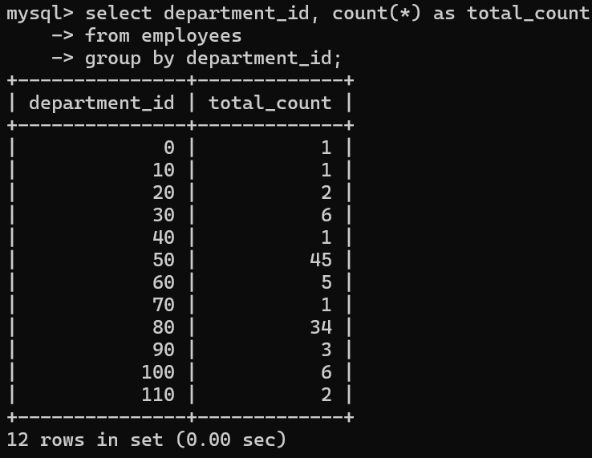
GROUP BY
Purpose:
Groups rows of data based on specified columns.
Enables aggregation and summarization of data at a higher level.
Usage:
Defines grouping criteria based on same values in specified columns
Aggregation functions are often used in conjunction to perform descriptive and summary calculations on grouped data.
GROUP BY typically appears after the FROM and WHERE clauses and before the HAVING clause
Applications:
Sales Analysis, Customer Segmentation

Slide 3
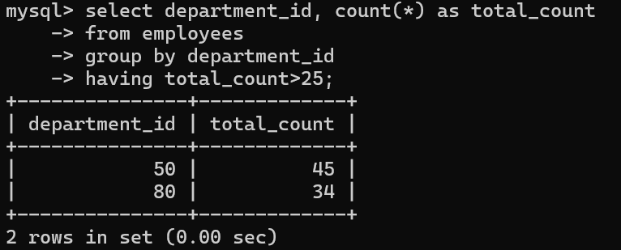
HAVING
Purpose:
Filters grouped data based on specified conditions after GROUP BY aggregation.
Allows filtering on aggregated values (e.g., SUM, AVG, COUNT) that cannot be used in the WHERE clause.
Usage:
Follows the GROUP BY clause in a SQL query.
Used to apply filtering conditions on aggregated data.
Conditions in HAVING are evaluated after rows are grouped and aggregated.
Applications:
Performance Monitoring, Data Filteration

Slide 4
AGGREGATE FUNCTIONS
2
3
4
5
COUNT()
SUM()
AVG()
MIN()
MAX()
Counts the number of rows.
Calculates the sum of values in a column.
Computes the average of values in a column.
Finds the minimum value in a column.
Finds the maximum value in a column.

Slide 5
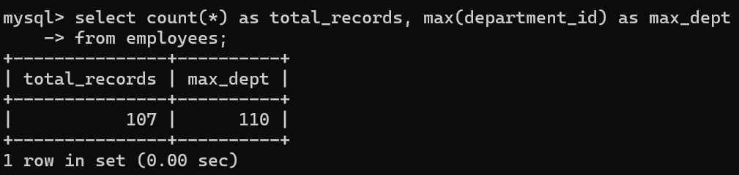
AGGREGATE FUNCTIONS
Purpose:
Perform calculations on sets of values and return a single result.
Usage:
Used in SELECT statements to compute values from columns or expressions.
Often applied within GROUP BY queries to generate aggregated results.
Can be used in conjunction with HAVING clause to filter grouped data based on aggregate results.
Applications:
Descriptive Analysis, Statistical Analysis

Slide 6
Thank You

